Slide 1
ASP.NET TECHNOLOGIES
CATEGORIES OF ASP.NET

Slide 2
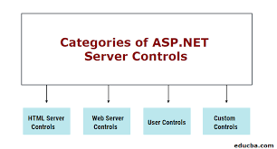
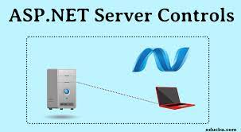
ASP.NET Web Server Controls

Slide 3
HTML Server Controls
HTML server controls are HTML elements (or elements in other supported markup, such as XHTML) containing attributes that make them programmable in server code. By default, HTML elements on an ASP.NET Web page are not available to the server. Instead, they are treated as opaque text and passed through to the browser. However, by converting HTML elements to HTML server controls, you expose them as elements you can program on the server.
The object model for HTML server controls maps closely to that of the corresponding elements. For example, HTML attributes are exposed in HTML server controls as properties.

Slide 4
HTML server controls offer the following features:
An object model that you can program against on the server using familiar object-oriented techniques. Each server control exposes properties that enable you to manipulate the control's markup attributes programmatically in server code.
A set of events for which you can write event handlers in much the same way you would in a client-based form, except that the event is handled in server code.
The ability to handle events in client script.
Automatic maintenance of the control's state. When the page makes a round trip to the server, the values that the user entered into HTML server controls are automatically maintained and sent back to the browser.
Interaction with ASP.NET validation controls so you can verify that a user has entered appropriate information into a control.

Slide 5
Web Server Controls
Web server controls are a second set of controls designed with a different emphasis. They do not necessarily map one-to-one to HTML server controls. Instead, they are defined as abstract controls in which the actual markup rendered by the control can be quite different from the model that you program against. Web server control might be rendered in a table or as inline text with other markup.
Web server controls include traditional form controls such as buttons and text boxes as well as complex controls such as tables. They also include controls that provide commonly used form functionality such as displaying data in a grid, choosing dates, displaying menus, and so on.

Slide 6
WEB SERVER CONTROLS OFFER THE FOLLOWING FEATURES:
A rich object model that provides type-safe programming capabilities.
Automatic browser detection. The controls can detect browser capabilities and render appropriate markup.
For some controls, the ability to define your own layout for the control using templates.
For some controls, the ability to specify whether a control's event causes immediate posting to the server or is instead cached and raised when the page is submitted.
Support for themes, which enable you to define a consistent look for controls throughout your site.
Ability to pass events from a nested control (such as a button in a table) to the container control.

Slide 7


